Slide 1
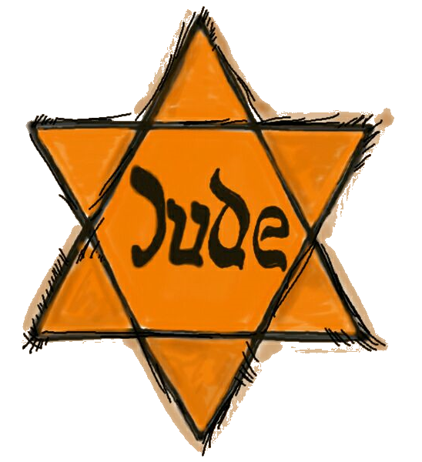
The Holocaust
The genocide committed by Nazi Germany against the Jews
Over 6 million Jews were murdered from across Europe
11 million were killed from other persecuted groups – Slavs, communists, religious dissenters, homosexuals, the disabled, etc.
Total killed in Nazi war atrocities number over 17 million

Slide 2
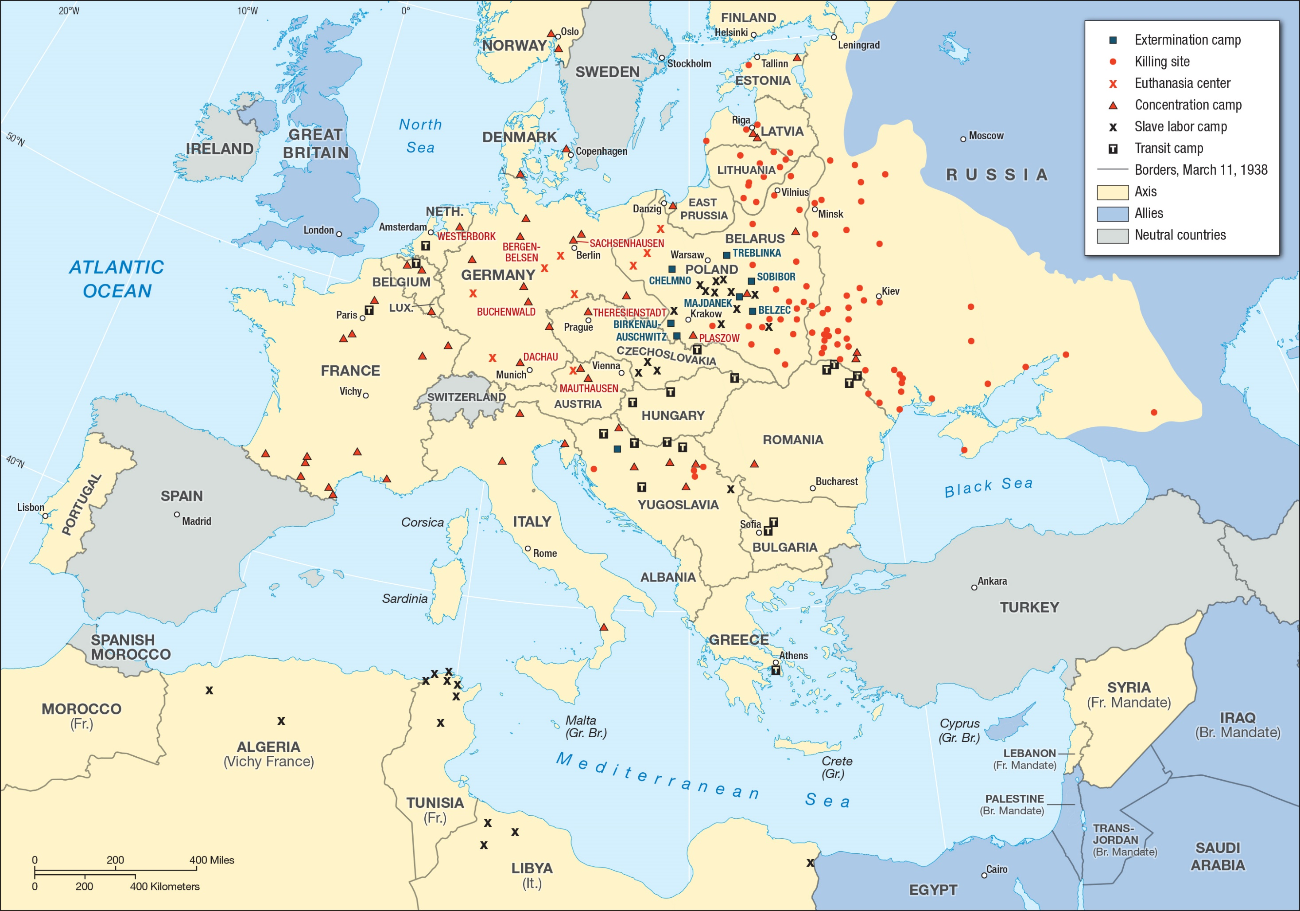

Slide 3
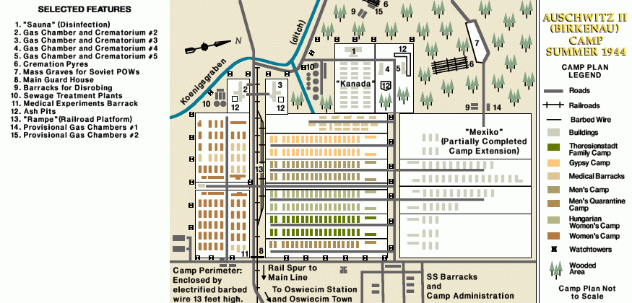

Slide 4
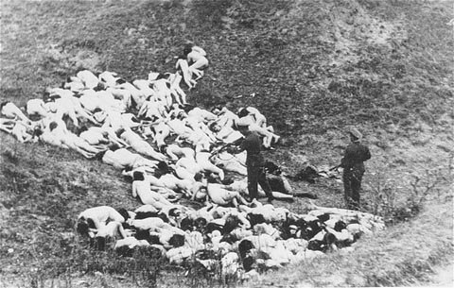
https://www.youtube.com/watch?v=vAhKvEgmxew&list=PLj1tRCohZq81aYbpsLMKimSXh2TibtwJW&index=3

Slide 5
Registration of new prisoners

Slide 6
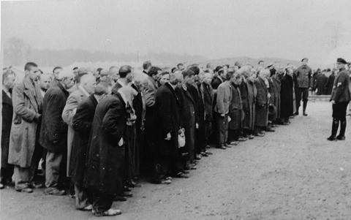
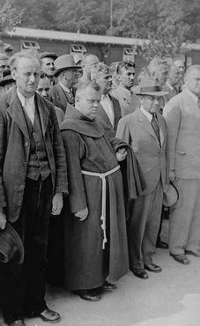
Newly arrived prisoners at roll call

Slide 7
Barracks at Auschwitz
Children in Auschwitz
Bags of human hair cut from prisoners

Slide 8
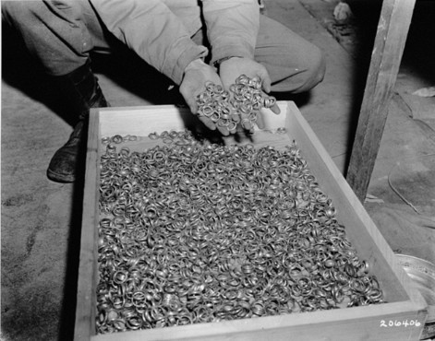
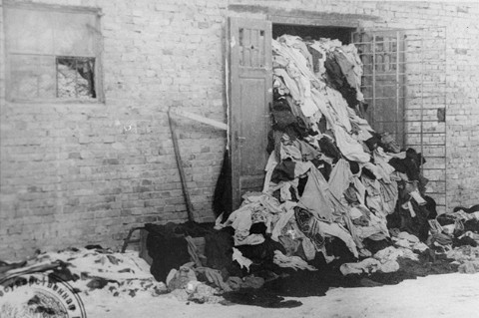
Clothing and rings taken from prisoners.

Slide 9
Prisoners walking by pile of shoes taken from murdered Jews
Prisoners in barracks

Slide 10
Forced labor
Executing a man kneeling before a mass grave
Digging their own graves before execution

Slide 11
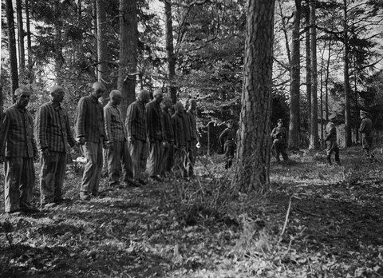
Awaiting execution

Slide 12
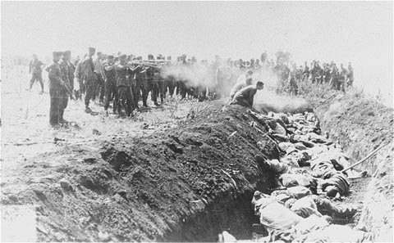
Mass execution

Slide 13
Mass grave

Slide 15
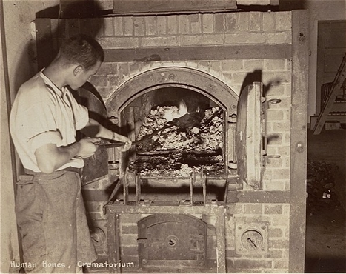
Human bones inside crematorium ovens (after being murdered in a gas chamber, bodies were oftentimes burned instead of buried).

Slide 16
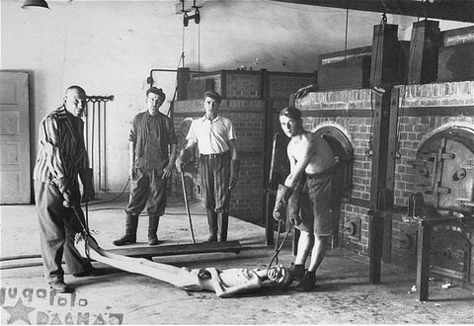
Prisoners placing bodies in the crematoriums
Human remains in a crematorium

Slide 17
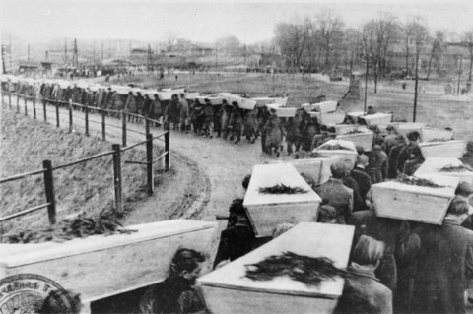
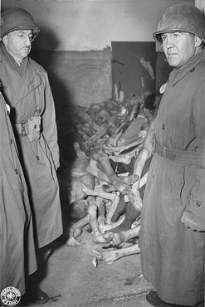
American congressman viewing a camp.
After the liberation, a funeral for those unsaved or killed.

Slide 18
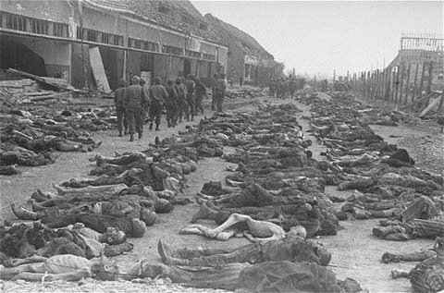
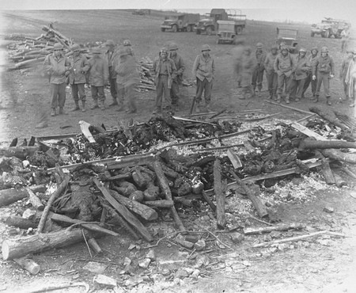

Slide 19
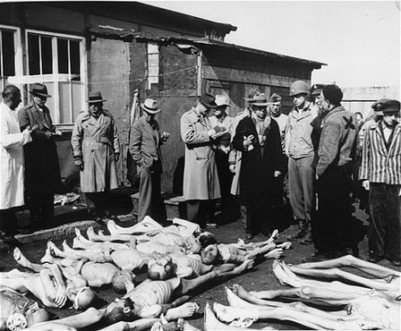
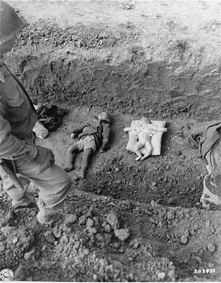
What the Allied soldiers saw at the camps, they would never forget.

Slide 20
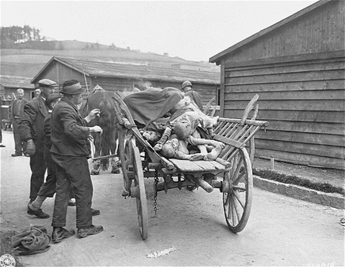
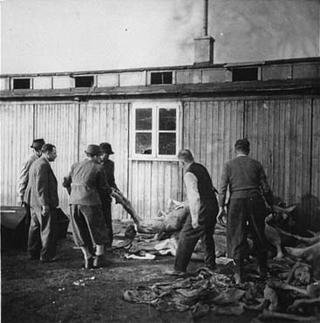
Austrian citizens assisting in the removal of corpses.

Slide 21
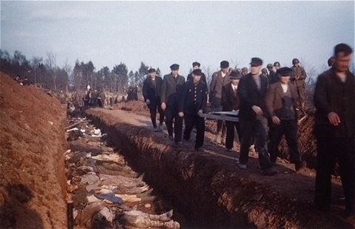
German civilians forced to assist in burial

Slide 22
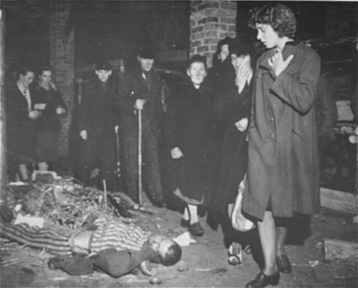
German civilians forced to walk through the camps, to witness what they had earlier chosen to ignore.

Slide 23
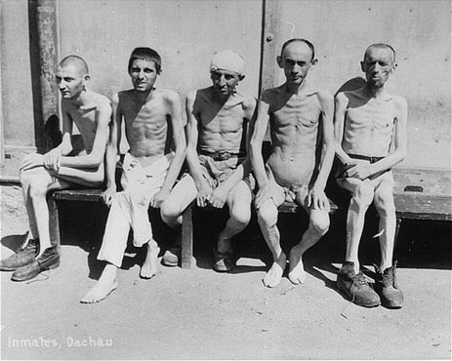

Slide 24
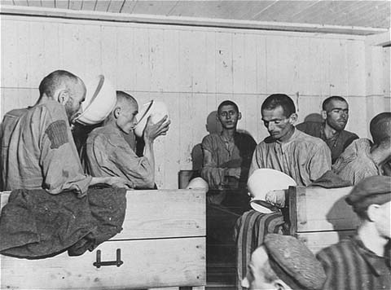
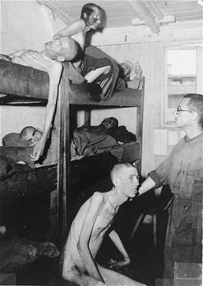
Survivors drinking broth provided by the U.S. Army

Slide 25
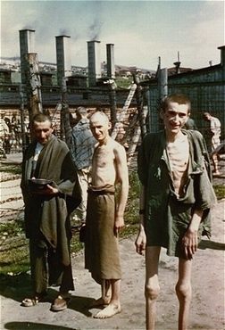
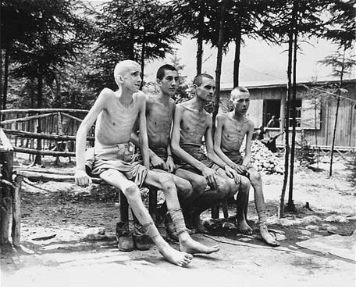
Survivors

Slide 26
